Slide 1
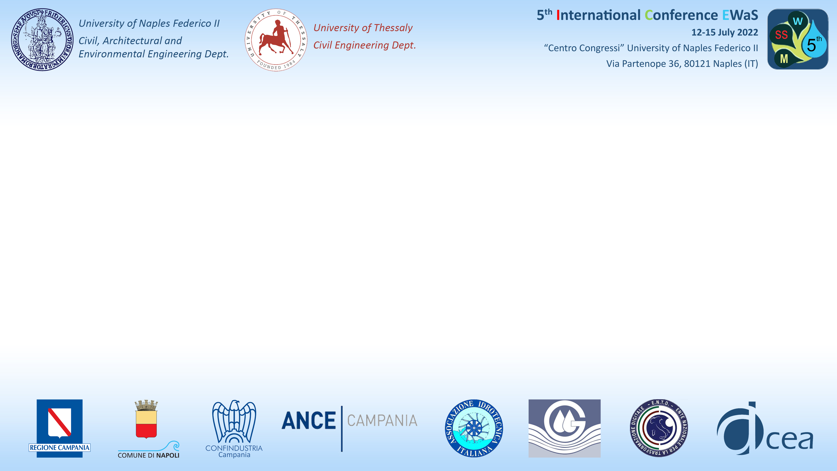



ON THE POTENTIAL OF A SMART CONTROL VALVE SYSTEM
FOR IRRIGATION WATER NETWORK MANAGEMENT
Ferrarese G^{.1}, Pagano A.², Fratino U.³, Malavasi S.¹
¹Politecnico di Milano, DICA (Italy)
²IRSA-CNR , Bari (Italy)
³Politecnico di Bari, DICATECh (Italy)

Slide 2


Ferrarese G.., Pagano A., Fratino U., Malavasi S. - ON THE POTENTIAL OF A SMART CONTROL VALVE SYSTEM FOR IRRIGATION WATER NETWORK MANAGEMENT
Position of the problem and objectives
Irrigated agriculture is being severely impacted by climate change. An increased water demand is foreseen together with a possible water scarcity intensification
Optimization of PIDS operations is needed to improve sustainability and resilience
Need to support the modernization and efficiency of PIDS, defining network management criteria and practices fostering digital transition and control optimization
Methodological approach and technological solution, for supporting an improved operation and management of on-demand PIDS
Objectives
Avoid/limit the critical conditions of PIDS introducing simple management rules implemented with the technological solution
5th International Conference EWaS
12-15 July 2022
“Centro Congressi” University of Naples Federico II

Slide 3
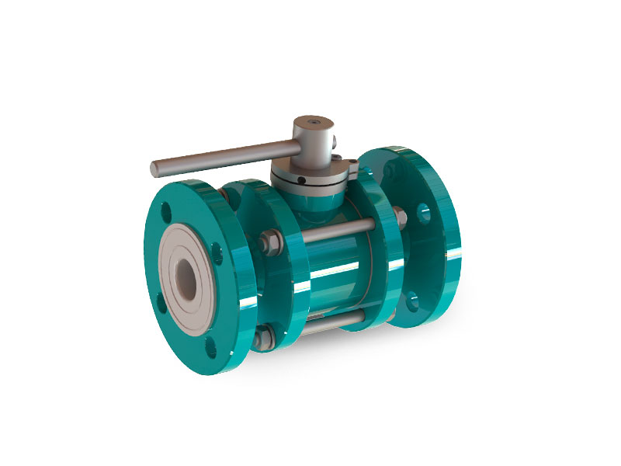
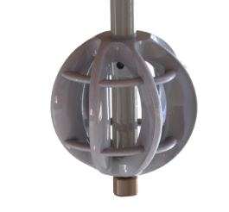
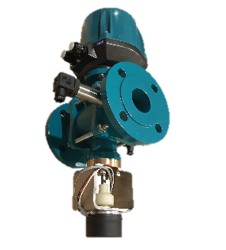
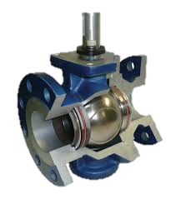




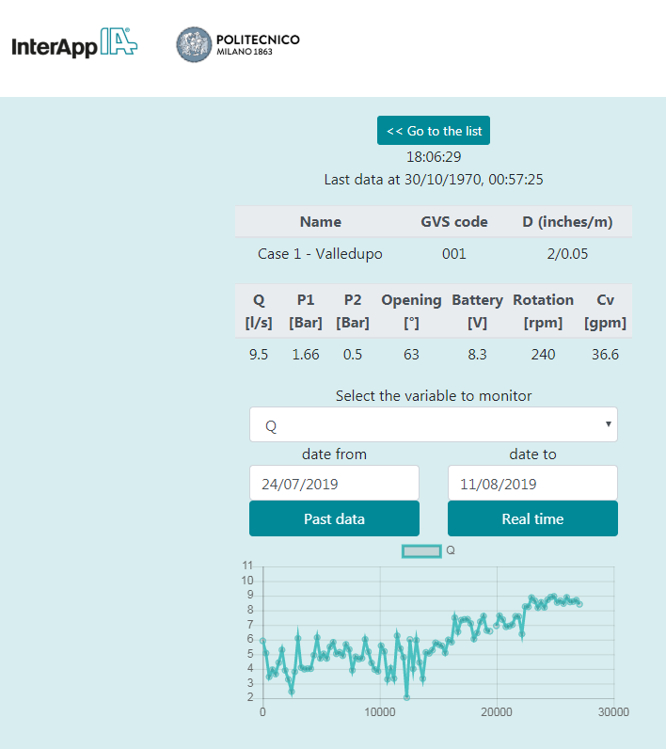
Ferrarese G.., Pagano A., Fratino U., Malavasi S. - ON THE POTENTIAL OF A SMART CONTROL VALVE SYSTEM FOR IRRIGATION WATER NETWORK MANAGEMENT
PATENT by Politecnico di Milano
The technological solution: the Green Valve
Innovative control valve which recovers part of the energy dissipated in the control process
Flow control
Energy harvesting
IoT self-sustainable control system
Actuator
Automatic actuation
GVS
Remote operation
Alert managing
Real time
Monitoring
Ball-valve
Turbine
Generator
Application to irrigation systems: improved management for water resources managers (rules), limitation of hydrant failure conditions, information to farmers
5th International Conference EWaS
12-15 July 2022
“Centro Congressi” University of Naples Federico II
Alternative application of the device that has been firstly developed for civil water distribution networks

Slide 4
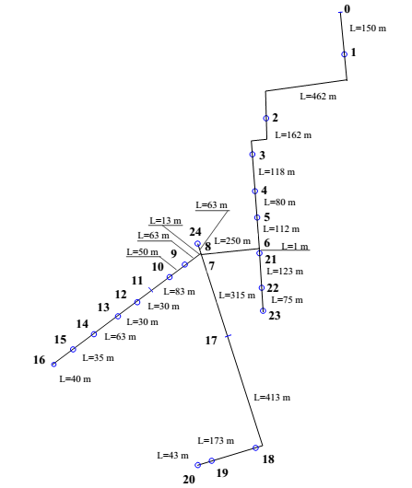
Ferrarese G.., Pagano A., Fratino U., Malavasi S. - ON THE POTENTIAL OF A SMART CONTROL VALVE SYSTEM FOR IRRIGATION WATER NETWORK MANAGEMENT
Sector 25
District 4
Sinistra Ofanto PID
Capitanata (Puglia, Southern Italy)
Overview of the methodological approach
PRELIMINARY HYDRAULIC MODELLING AND NETWORK ASSESSMENT
EPANET-Matlab Toolkit
Eliades (2016)
Definition of boundary conditions
Recursive hydraulic simulations
Identification of critical nodes
INTEGRATED MODELING
GVS
NETWORK
Analysis of GVS operating conditions
Sizing, opening degree and efficiency
Computation of potential energy recovery
Identification of suitable rules to reduce failures (non contemporaneity)
Computation of hydraulic variables
24 nodes
19 hydrants
DESIGN OF THE SET OF GVS AND FINAL NETWORK ASSESSMENT
5th International Conference EWaS
12-15 July 2022
“Centro Congressi” University of Naples Federico II
Ferrarese G., Pagano A., Fratino U., Malavasi S. Improving Operation of Pressurized Irrigation Systems by an Off-grid Control Devices Network (2021) Water Resources Management, DOI: 10.1007/s11269-021-02869-5

Slide 5
Ferrarese G.., Pagano A., Fratino U., Malavasi S. - ON THE POTENTIAL OF A SMART CONTROL VALVE SYSTEM FOR IRRIGATION WATER NETWORK MANAGEMENT
Boundary conditions
Monthly variation of boundaries and operating conditions, during the irrigation season (April - November)
Variable upstream head from 143 m at the beginning of the irrigation season to 128 m, corresponding to the peak demand and the lowest water availability
Variable number of operating hydrants
Hydrant parameters: 10 l/s and 20 m of head
Contemporary hydrants | Apr [%] | May [%] | Jun [%] | Jul [%] | Aug [%] | Sept [%] | Oct [%] | Nov [%]
3 | 1 |  |  |  |  |  |  | 1
4 |  | 0.5 | 0.3 |  |  | 0.3 | 0.5
5 |  | 0.5 | 0.3 | 0.3 | 0.3 | 0.3 | 0.5
6 |  |  | 0.4 | 0.3 | 0.3 | 0.4
7 |  |  |  | 0.4 | 0.4
Water demand[m³] | 540 | 720 | 900 | 1180 | 1296 | 1080 | 900 | 540
Inlet Head [m] | 140 | 136 | 132 | 131 | 128 | 131 | 133 | 139
Preliminary results
No failures for less than 5 simultaneous hydrants
No failures for upstream head above 140m
14 of the hydrants experience critical conditions
5th International Conference EWaS
12-15 July 2022
“Centro Congressi” University of Naples Federico II
Simultaneous Hydrants | Apr | May | Jun | Jul | Aug | Sep | Oct | Nov
3 | 1 |  |  |  |  |  |  | 1
4 |  | 0.5 | 0.3 |  |  | 0.3 | 0.5
5 |  | 0.5 | 0.3 | 0.3 | 0.3 | 0.3 | 0.5
6 |  |  | 0.4 | 0.3 | 0.3 | 0.4
7 |  |  |  | 0.4 | 0.4
Total vol [m³] | 540 | 720 | 900 | 1080 | 1296 | 1080 | 900 | 540

Slide 6
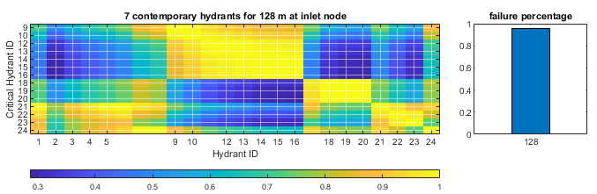

Ferrarese G.., Pagano A., Fratino U., Malavasi S. - ON THE POTENTIAL OF A SMART CONTROL VALVE SYSTEM FOR IRRIGATION WATER NETWORK MANAGEMENT
Identification of critical hydrants
Identification of potential critical combinations of hydrants, based on the level of ‘interaction’ → Matrices define hydrant concurrency in failure conditions
Evaluation of the couple of hydrants whose contemporary functioning should be avoided to reduce the overall failure occurrence.
$$C_{i, j}=\frac{\sum_{r}{{Ih}_{i,r}∙{Ic}_{i,r}∙{Ih}_{j,r}}}{\sum_{r}{{Ih}_{i,r}}}$$
Clusters of critical hydrants are highlighted
5th International Conference EWaS
12-15 July 2022
“Centro Congressi” University of Naples Federico II
Number of contemporary hydrants and inlet pressure change abruptly the number failures

Slide 7
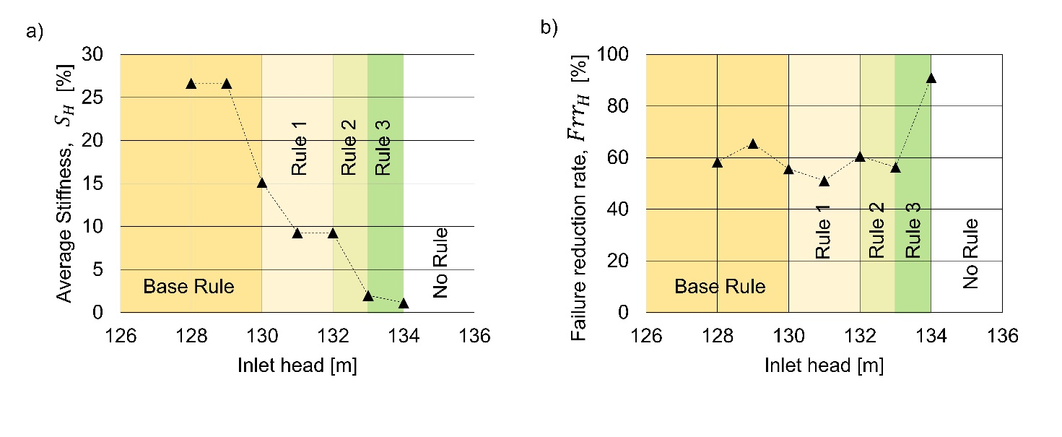
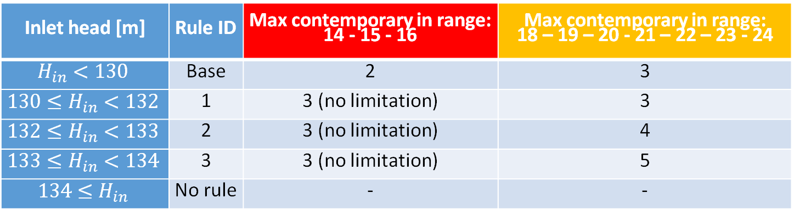
Ferrarese G.., Pagano A., Fratino U., Malavasi S. - ON THE POTENTIAL OF A SMART CONTROL VALVE SYSTEM FOR IRRIGATION WATER NETWORK MANAGEMENT
Some results
Definition of adaptive management rules that prevents contemporary use of hydrants in clusters
Inlet head [m] | Rule ID | Max contemporary in range: 14 - 15 - 16 | Max contemporary in range: 18 – 19 – 20 - 21 – 22 – 23 - 24
$$H_{in}<130$$ | Base | 2 | 3
$${130≤H}_{in}<132$$ | 1 | 3 (no limitation) | 3
$${132≤H}_{in}<133$$ | 2 | 3 (no limitation) | 4
$${133≤H}_{in}<134$$ | 3 | 3 (no limitation) | 5
$${134≤H}_{in}$$ | No rule | - | -
Adaptive rule limit the severity keeping failure reduction rate
5th International Conference EWaS
12-15 July 2022
“Centro Congressi” University of Naples Federico II

Slide 8
Ferrarese G.., Pagano A., Fratino U., Malavasi S. - ON THE POTENTIAL OF A SMART CONTROL VALVE SYSTEM FOR IRRIGATION WATER NETWORK MANAGEMENT
The technological solution can implement the rules
GVS are thought to be installed in several nodes of the network in order to actuate management rules
Limit failure occurrence
Additional functions to farmers:
-pressure and flow rate real-time monitoring
-historical of the data
-remote operation
Additional functions to managers:
-real-time state of the network
-water usage
-rule management
Cluster 2
Cluster 1
5th International Conference EWaS
12-15 July 2022
“Centro Congressi” University of Naples Federico II

Slide 9
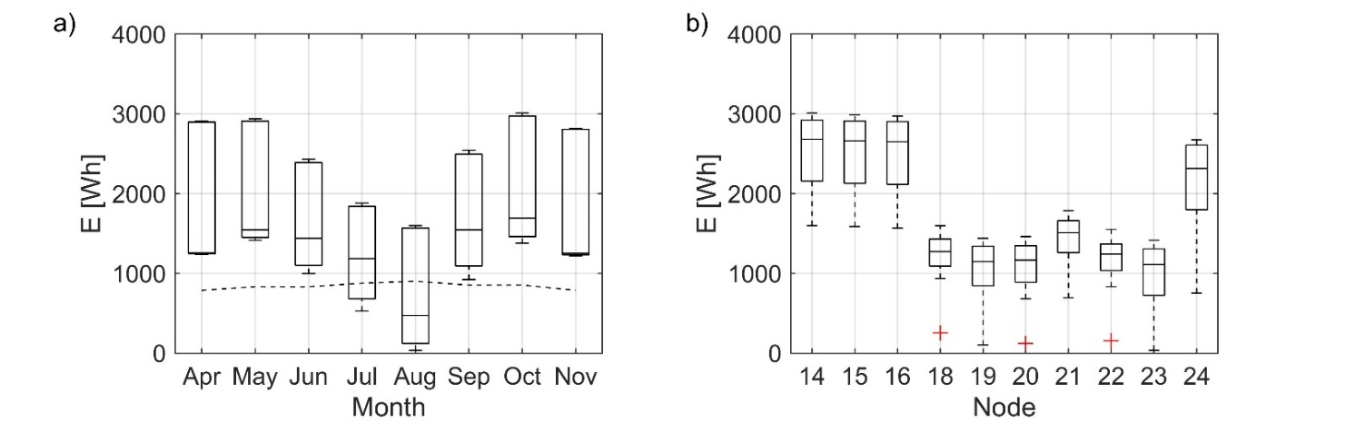
Ferrarese G.., Pagano A., Fratino U., Malavasi S. - ON THE POTENTIAL OF A SMART CONTROL VALVE SYSTEM FOR IRRIGATION WATER NETWORK MANAGEMENT
Some results
Green Valve energetic sustainability
Recovered energy
Recovered energy
Energetically critical months
Minimum necessary
Energy
Minimum necessary
Energy in worse condition
Battery size increase
Recovered energy is critical in some nodes, but the average is always above the minimum necessary energy
5th International Conference EWaS
12-15 July 2022
“Centro Congressi” University of Naples Federico II
Positive overall monthly balance

Slide 10
Ferrarese G.., Pagano A., Fratino U., Malavasi S. - ON THE POTENTIAL OF A SMART CONTROL VALVE SYSTEM FOR IRRIGATION WATER NETWORK MANAGEMENT
Conclusions and way forward
The proposed methodological approach guarantees a straightforward identification of potential failure conditions and critical combinations of hydrants
The technological solution proposed (GVS) can implement the management rules proposed thanks to the additional functionalities of GVS
The introduction of adaptive rules based on inlet pressure reduces the number of combinations prevented by the rule keeping effectiveness of the approach
The GVS is energetically sustainable
Improve the design of GVS considering the specificities of the application
Application of the methodology to more complex networks
5th International Conference EWaS
12-15 July 2022
“Centro Congressi” University of Naples Federico II

Slide 11
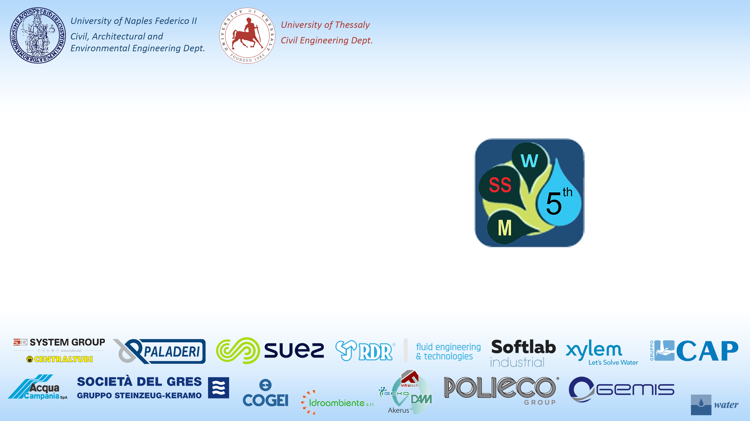
Thank you!
giacomo.ferrarese@polimi.it
alessandro.pagano@ba.irsa.cnr.it
umberto.fratino@poliba.it
stefano.malavasi@polimi.it
On the approach
Ferrarese G., Pagano A., Fratino U., Malavasi S. Improving Operation of Pressurized Irrigation Systems by an Off-grid Control Devices Network (2021) Water Resources Management, DOI: 10.1007/s11269-021-02869-5
On the GVS
Malavasi S, Rossi MMA, Ferrarese G (2016) GreenValve: hydrodynamics and applications of the control valve for energy harvesting. Urban Water J 15:200–209. https://doi.org/10.1080/1573062X.2016.1175483

Slide 12
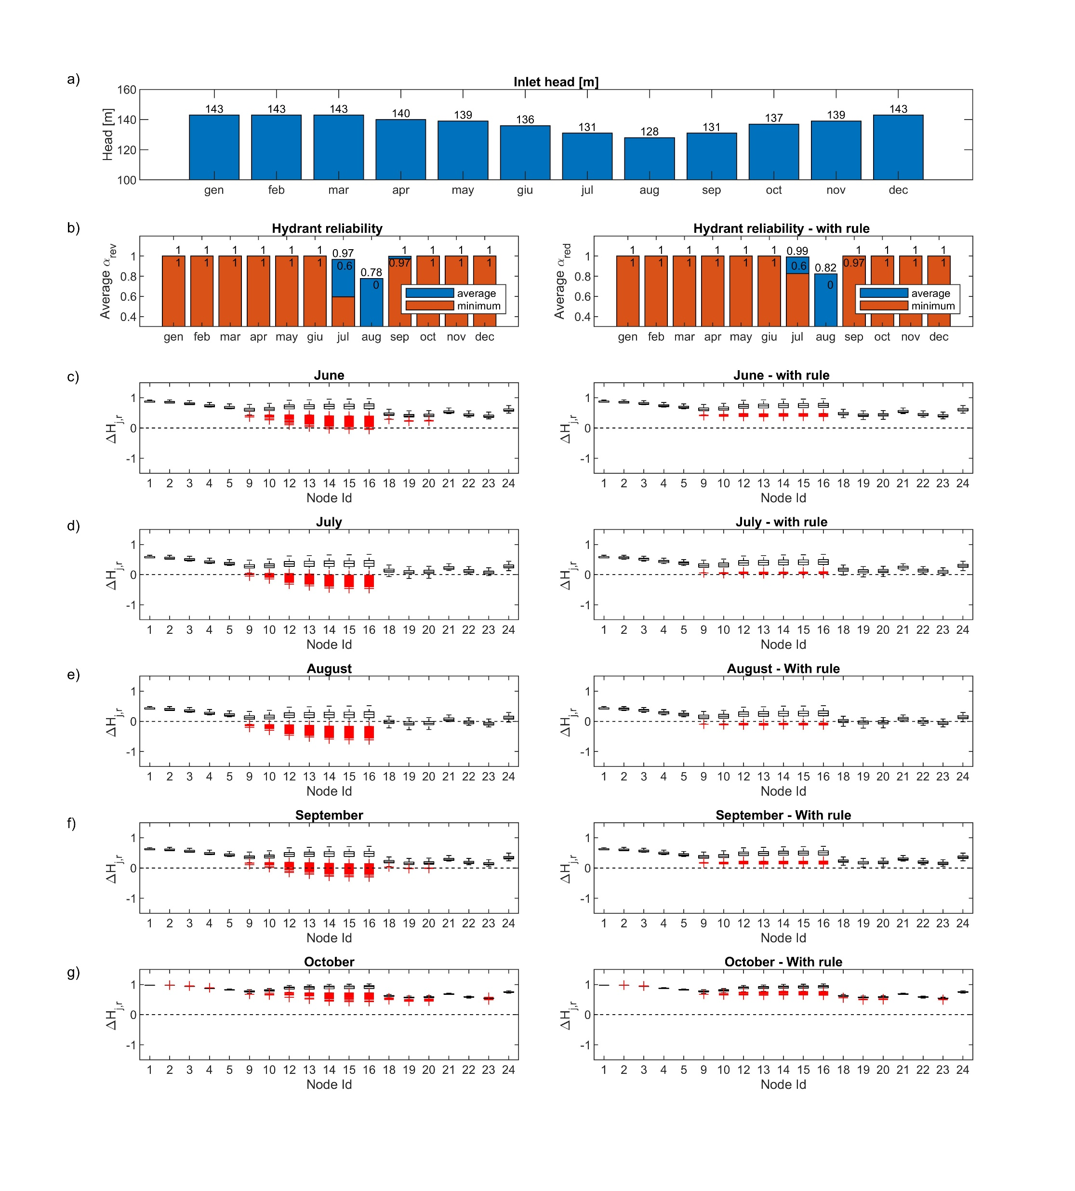
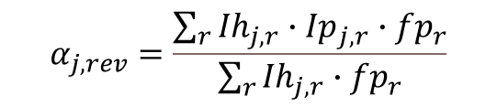
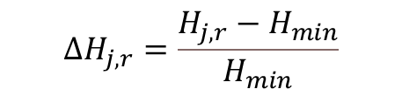
Ferrarese G.., Pagano A., Fratino U., Malavasi S. - ON THE POTENTIAL OF A SMART CONTROL VALVE SYSTEM FOR IRRIGATION WATER NETWORK MANAGEMENT
Some results
Relative pressure deficit
$${ΔH}_{j,r}=\frac{H_{j,r}−H_{min}}{H_{min}}$$
Hydrant reliability
[modified with a weight fp_{r} depending of the probability of occurrence of each configuration]
$$α_{j, rev}=\frac{\sum_{r}{{Ih}_{j,r}∙{Ip}_{j,r}∙{fp}_{r}}}{\sum_{r}{{Ih}_{j,r}∙{fp}_{r}}}$$
5th International Conference EWaS
12-15 July 2022
“Centro Congressi” University of Naples Federico II

Slide 13


Ferrarese G.., Pagano A., Fratino U., Malavasi S. - ON THE POTENTIAL OF A SMART CONTROL VALVE SYSTEM FOR IRRIGATION WATER NETWORK MANAGEMENT
Some results
Definition of a management rule (operationalized through the GV).
10 devices are installed at some of the most critical hydrants (i.e. #14, 15, 16, 18, 19, 20, 21, 22, 23, 24) and can prevent the simultaneity:
For the nodes # 18, 19, 20, 21, 22, 23, 24 of three hydrants.
For the nodes # 14, 15, 16 of two hydrants.
Some critical combinations are not excluded. The installation of additional GVs can help improving the quality of control and management
5th International Conference EWaS
12-15 July 2022
“Centro Congressi” University of Naples Federico II

